Slide 1


Missing People Database Management System
A Project by Laxman Kumar and Sarthak Tandon

Slide 2


The Case of Missing people
India has a very high volume of child trafficking and missing people. Thousands of people go missing with many untraced and unidentified.
Missing or abducted children are forced to beg on the street or have to indulge in other vices.
Trafficking of young girls (under age of 18) has grown 14 times over the last decade according to the National Crime Record Bureau. In India specifically, it is estimated that there are around 135,000 children trafficked each year.
The root cause of child trafficking in India is due to
Poverty
need to support family which cause child labor
lack of education.

Slide 3
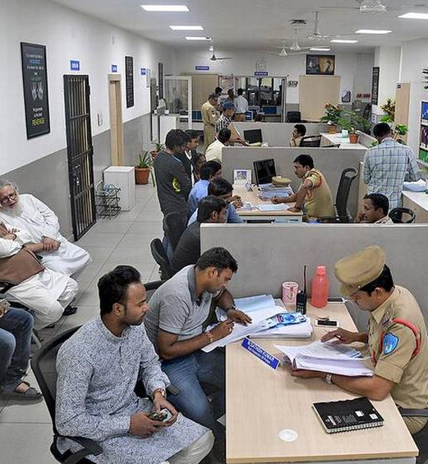
The Current Scenario
India still lacks a system to track and identify missing people.
There is no system available or dataset which can be used to trace people.
The only data available is in the form of First Information Report (F.I.R.) which is filed by the law enforcement during the complain of the missing people and that information also lacks any digital coherency.

Slide 4

Our Solution
Our Solution will be used to keep track of the Data for Unidentified and Missing persons.
The system will bridge the gap between the populous and the authorities and will promote transparency.
The data base will digitize the process of filing complaint and improve the data storage, getting rid of any delays from the authorities and red tapism, which exists in the current environment.
The responsible authorities can use the same data to carry out their investigation and close the case on time.
It will also eliminate any human error which exists when filling reports and allotting cases.

Slide 5
Major Data Questions
Which officer is assigned to the complaint filed?
Whether the search operation is carried out or not?
Which department has the largest pending missing complaint?
How many missing people are reported, by city and state?
Which police department has the highest case solving rate?

Slide 6
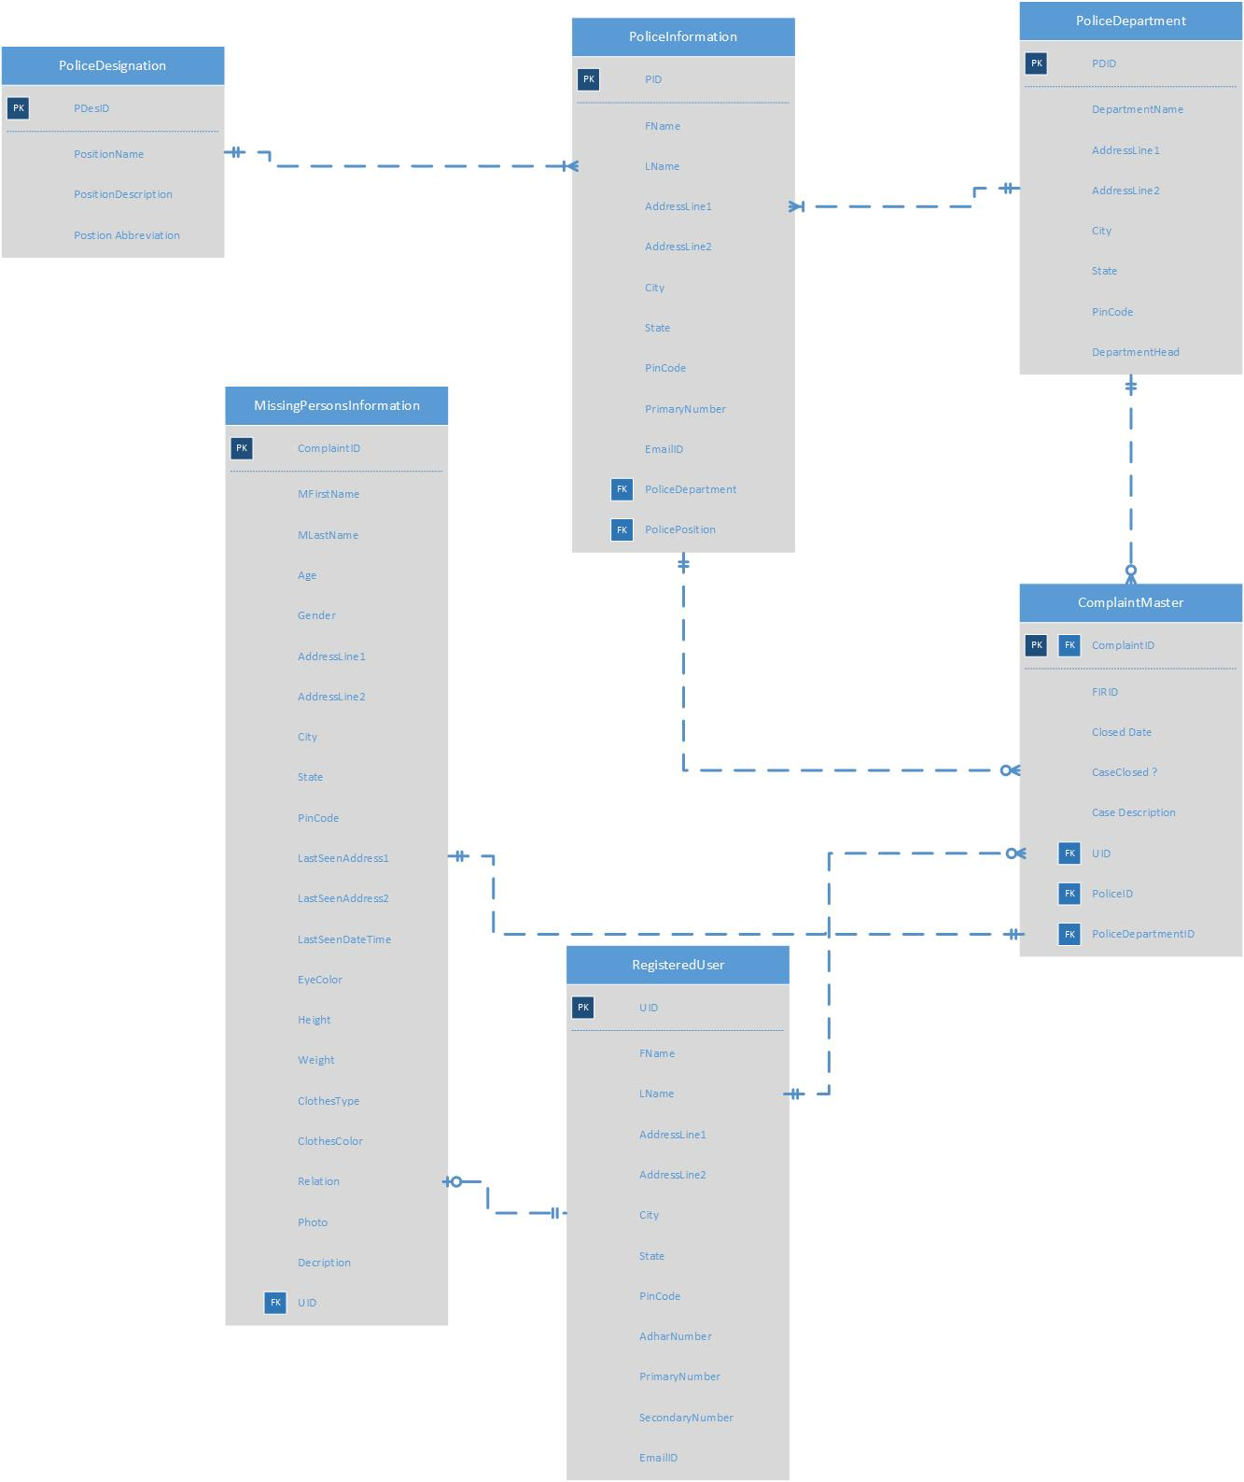
ER diagram of our model

Slide 7

Form Demo Slides

Slide 8
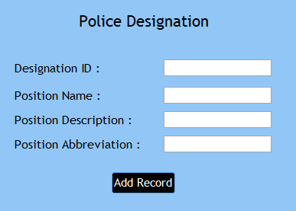
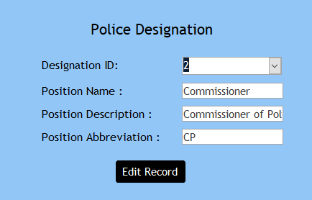
The Police Designation form
Add Record
Edit Record

Slide 9
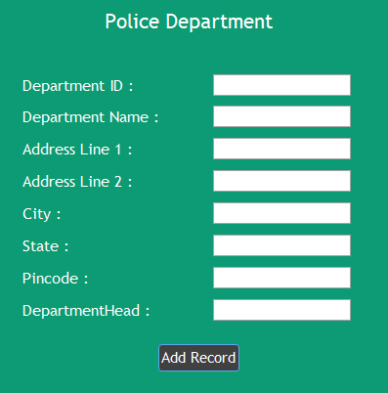
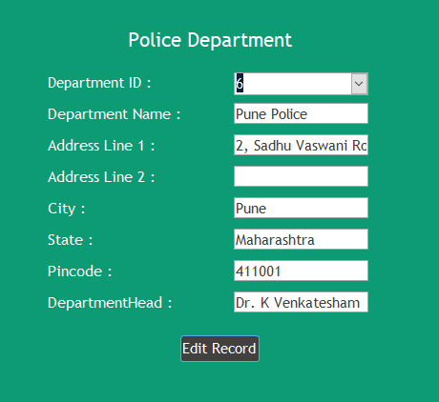
The Police Department From
Add Record
Edit Record

Slide 10
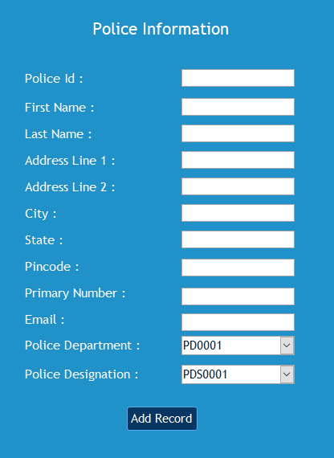
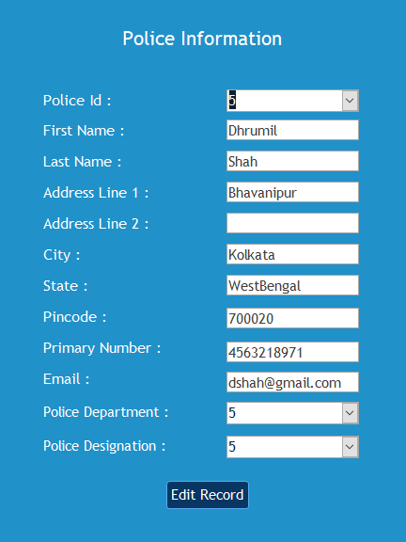
The Police Information form
Edit Record
Add Record

Slide 11
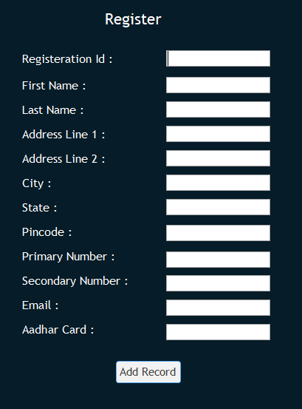
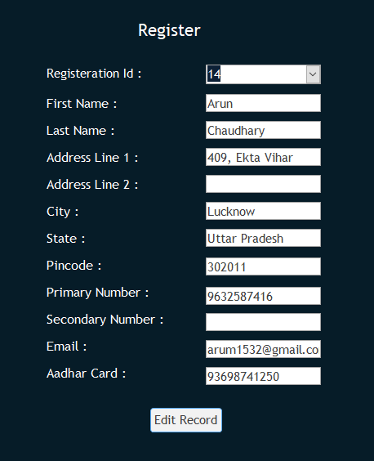
The Registered User from
Add Record
Edit Record

Slide 12
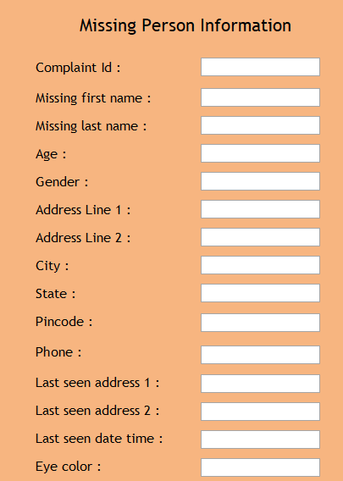
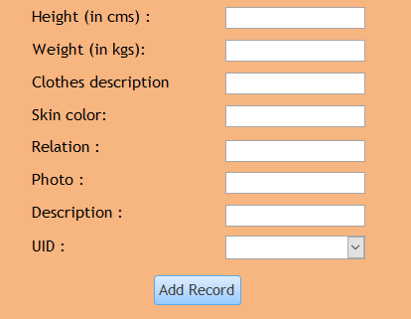
The Missing Person form
Add Record

Slide 13
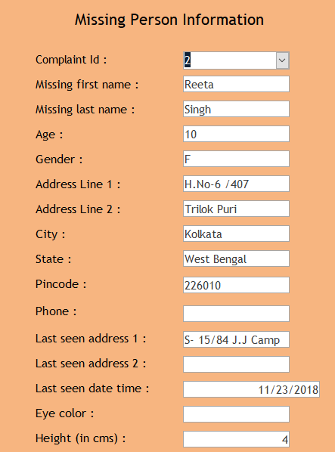
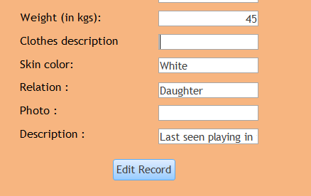
Edit Record

Slide 14
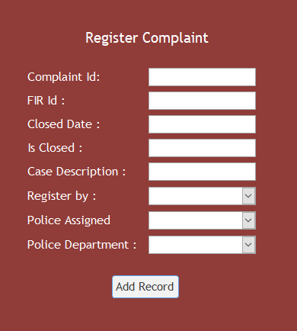
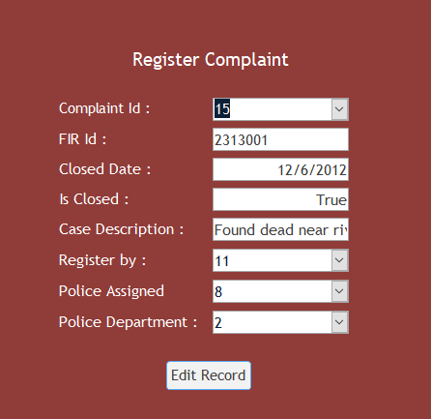
Complaint Master
Add Record
Edit Record

Slide 15

Reports

Slide 16
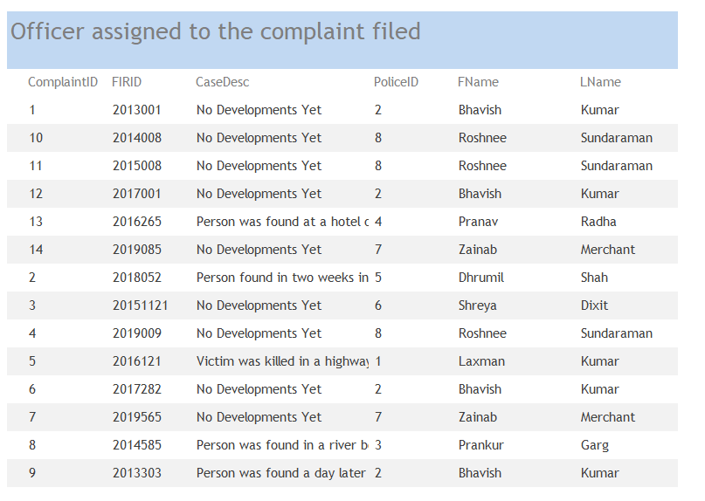
Data Question 1: Which officer is assigned to the complaint filed?

Slide 17
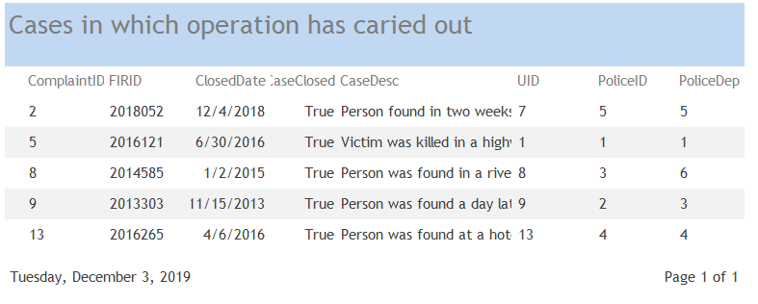
Data Question 2: Whether the search operation is carried out or not?

Slide 18
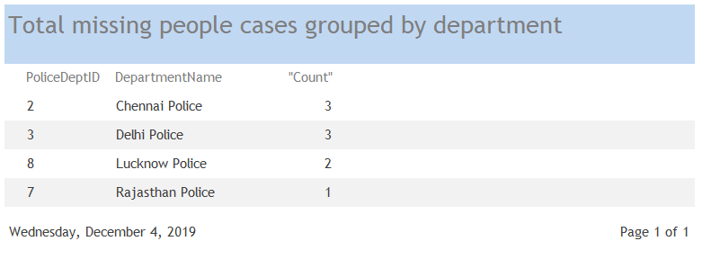
Data Question 3: Which department has how many pending cases?

Slide 19
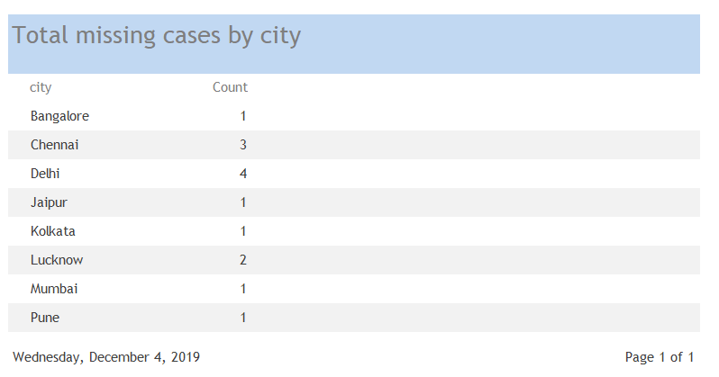
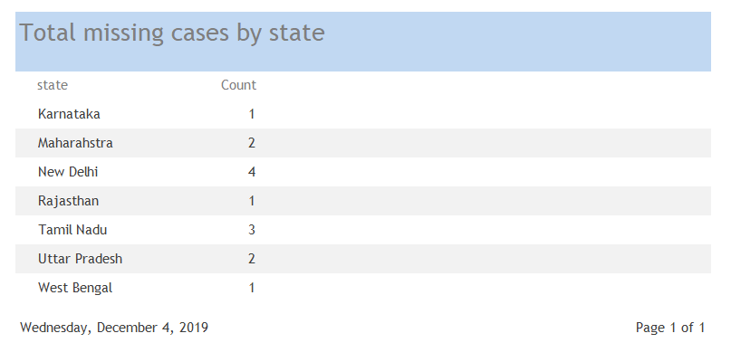
Data Question 4: How many missing people are reported, by city and state?

Slide 20
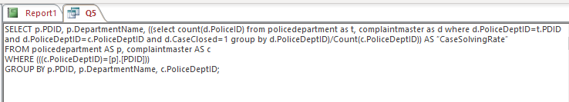
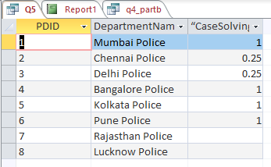
Data Question 5: Which police department has the highest case solving rate?

Slide 21

Hybrid Mobile App

Slide 22
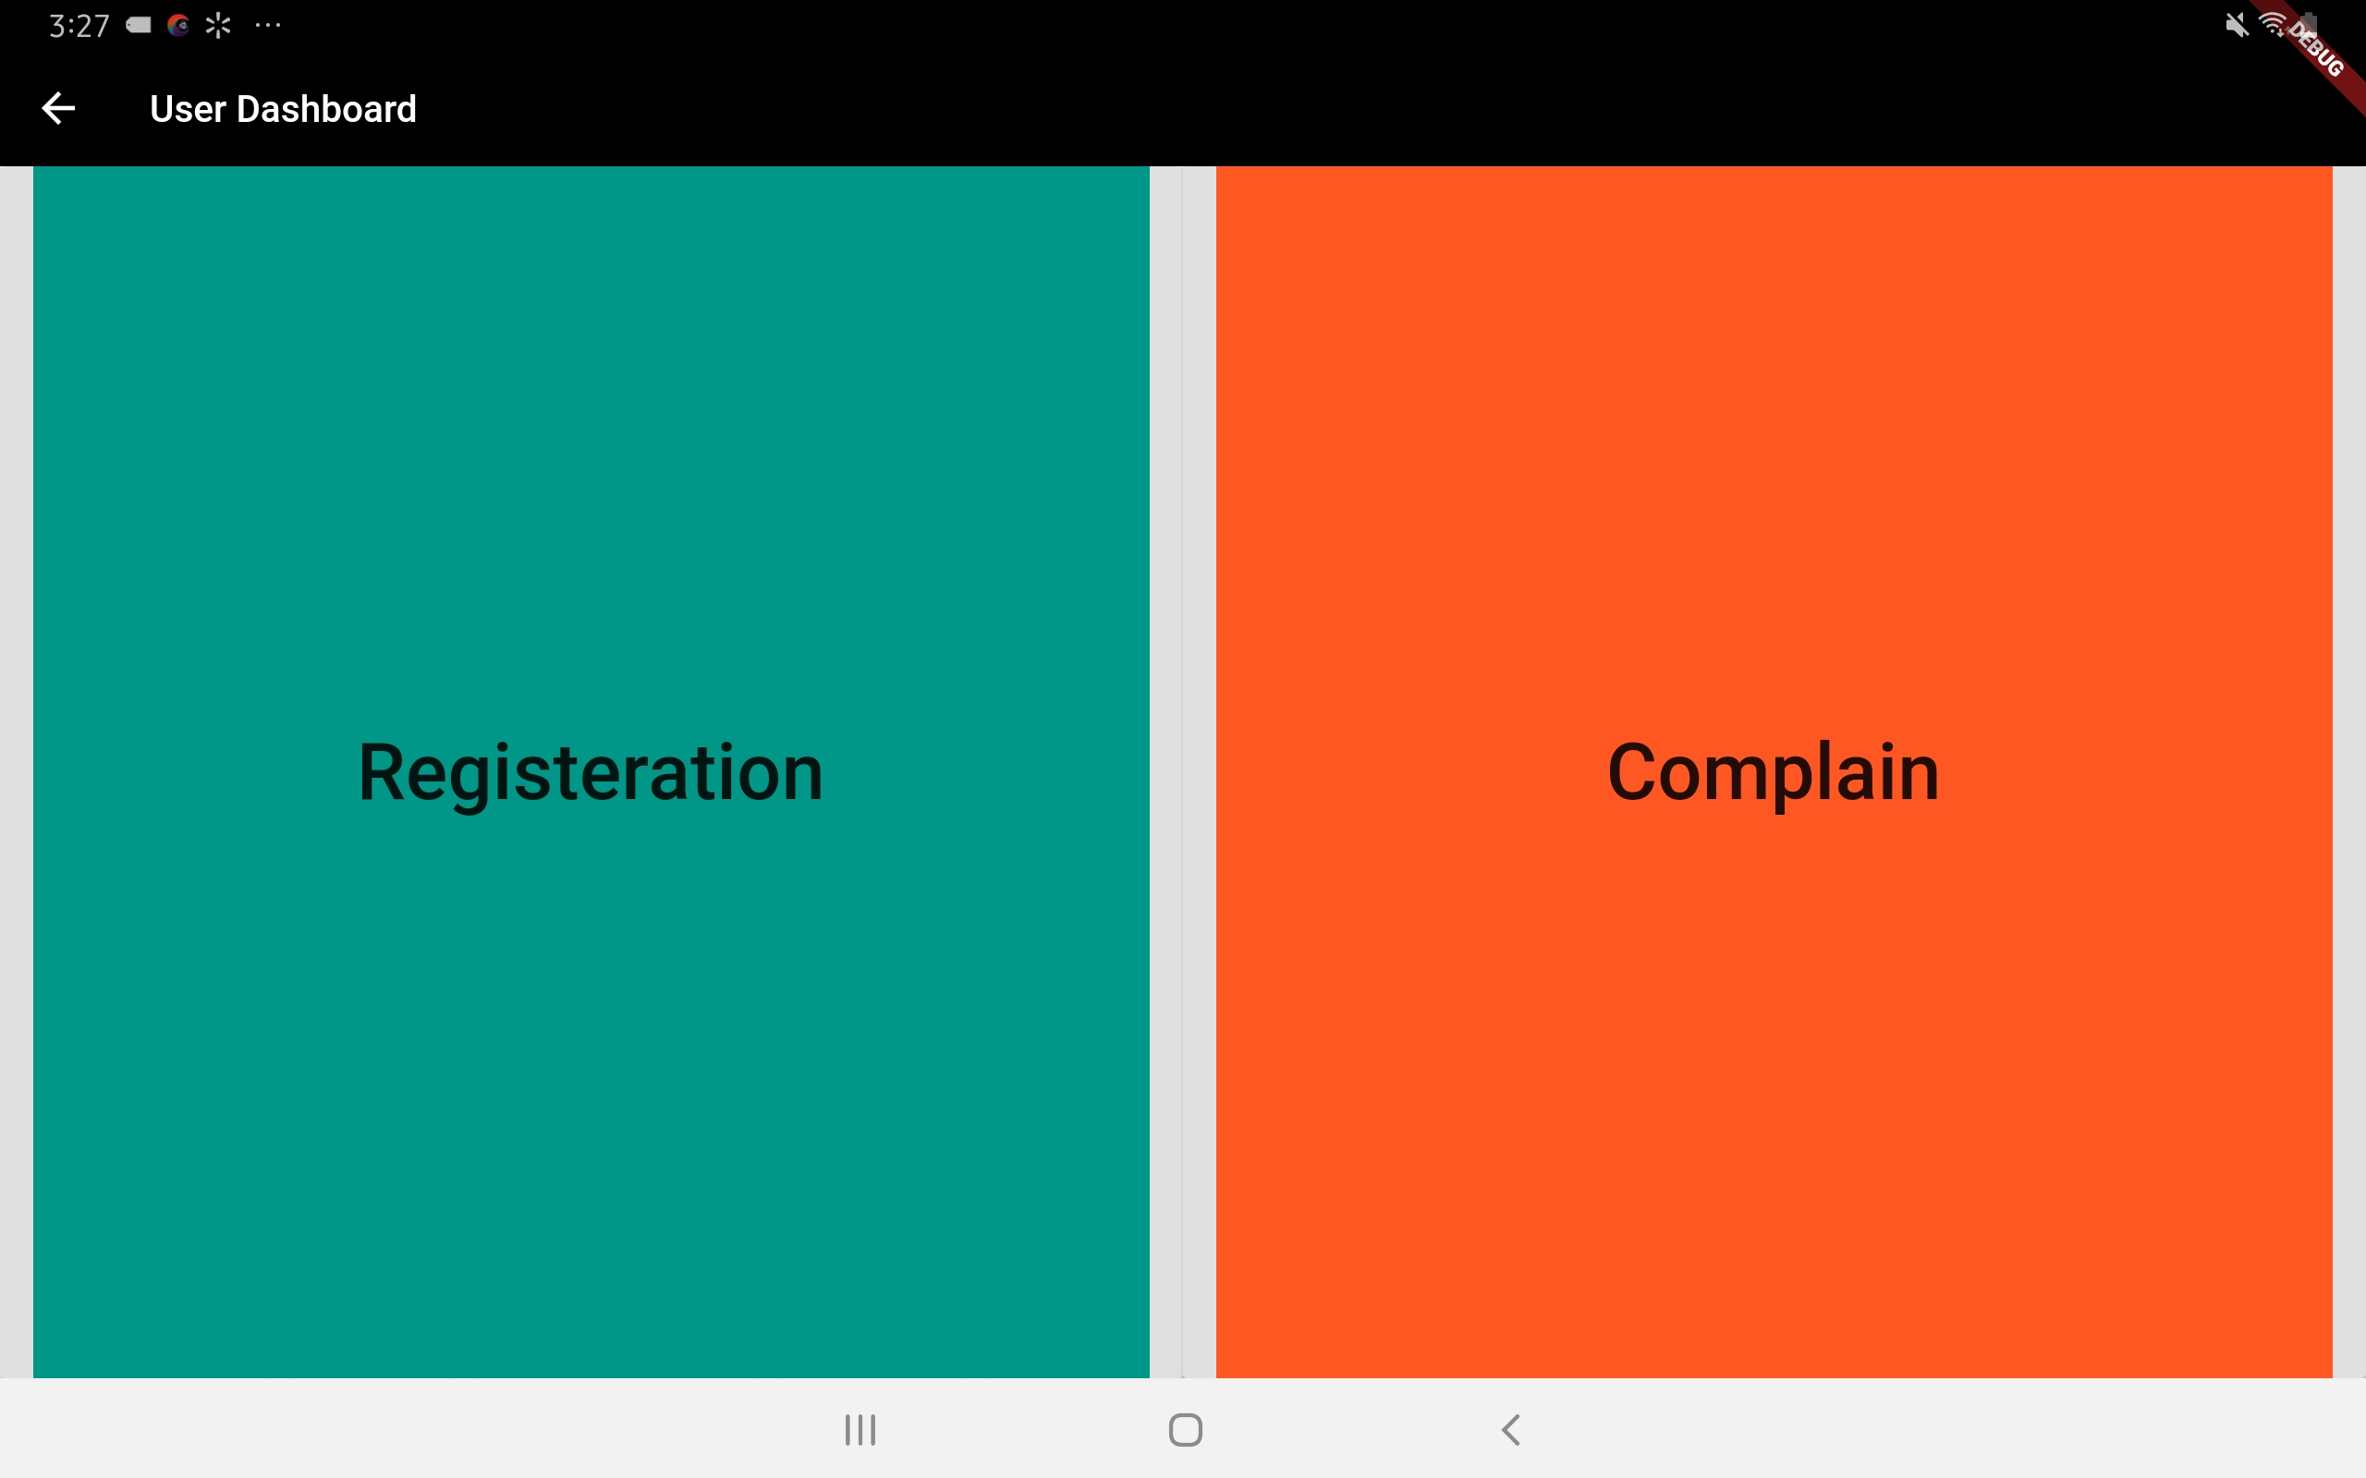
Dashboard

Slide 23
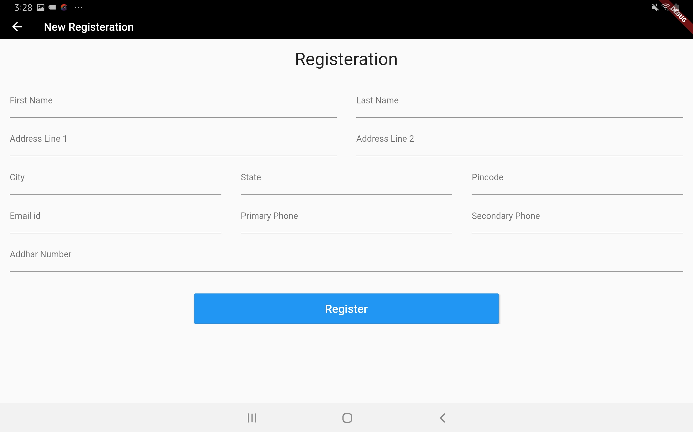
Registration page

Slide 24
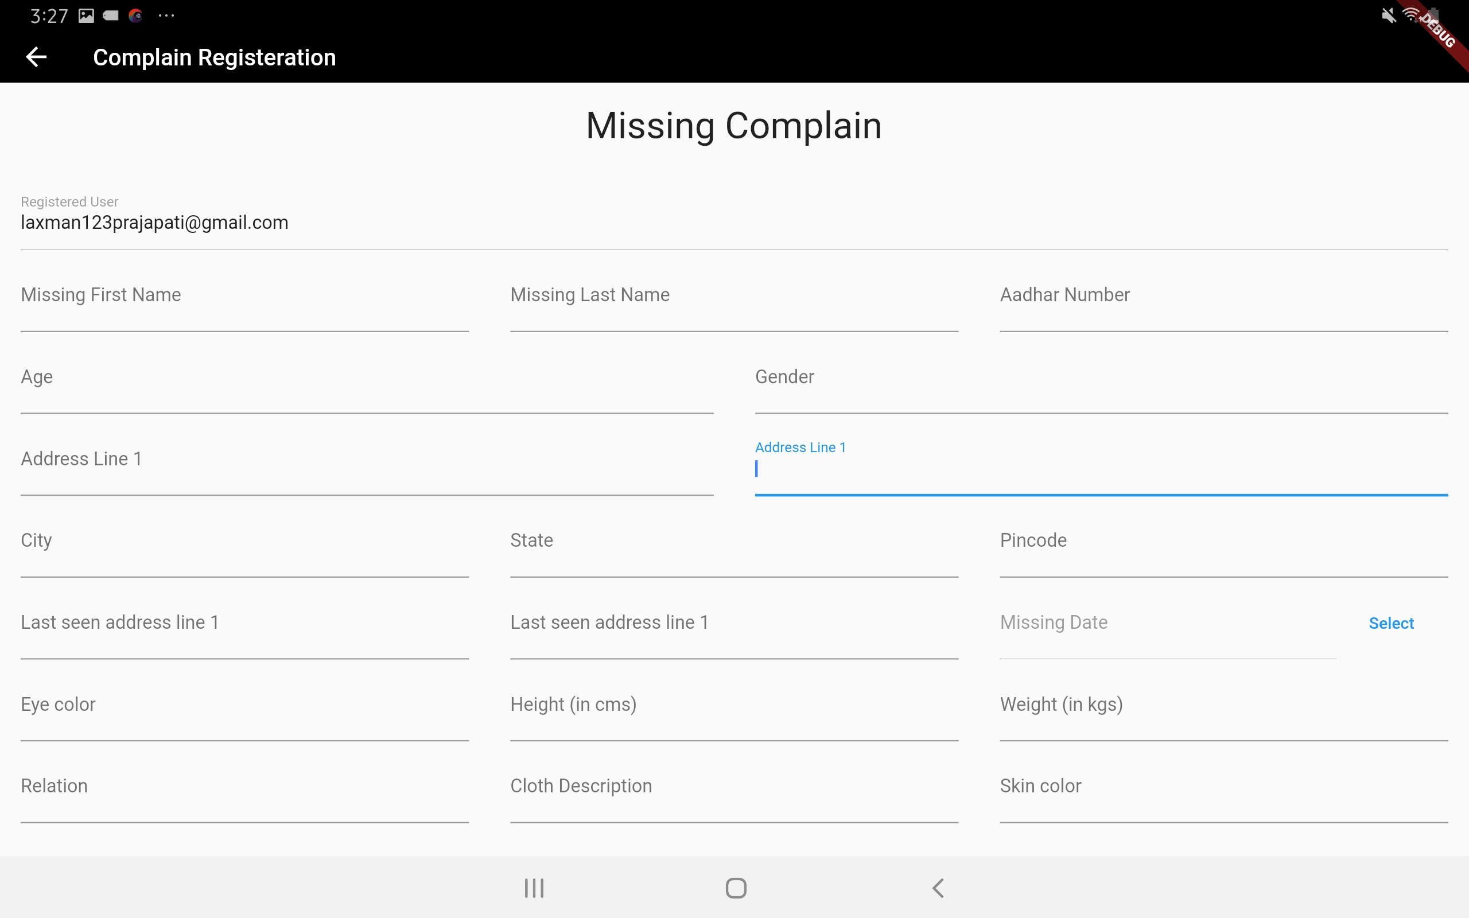
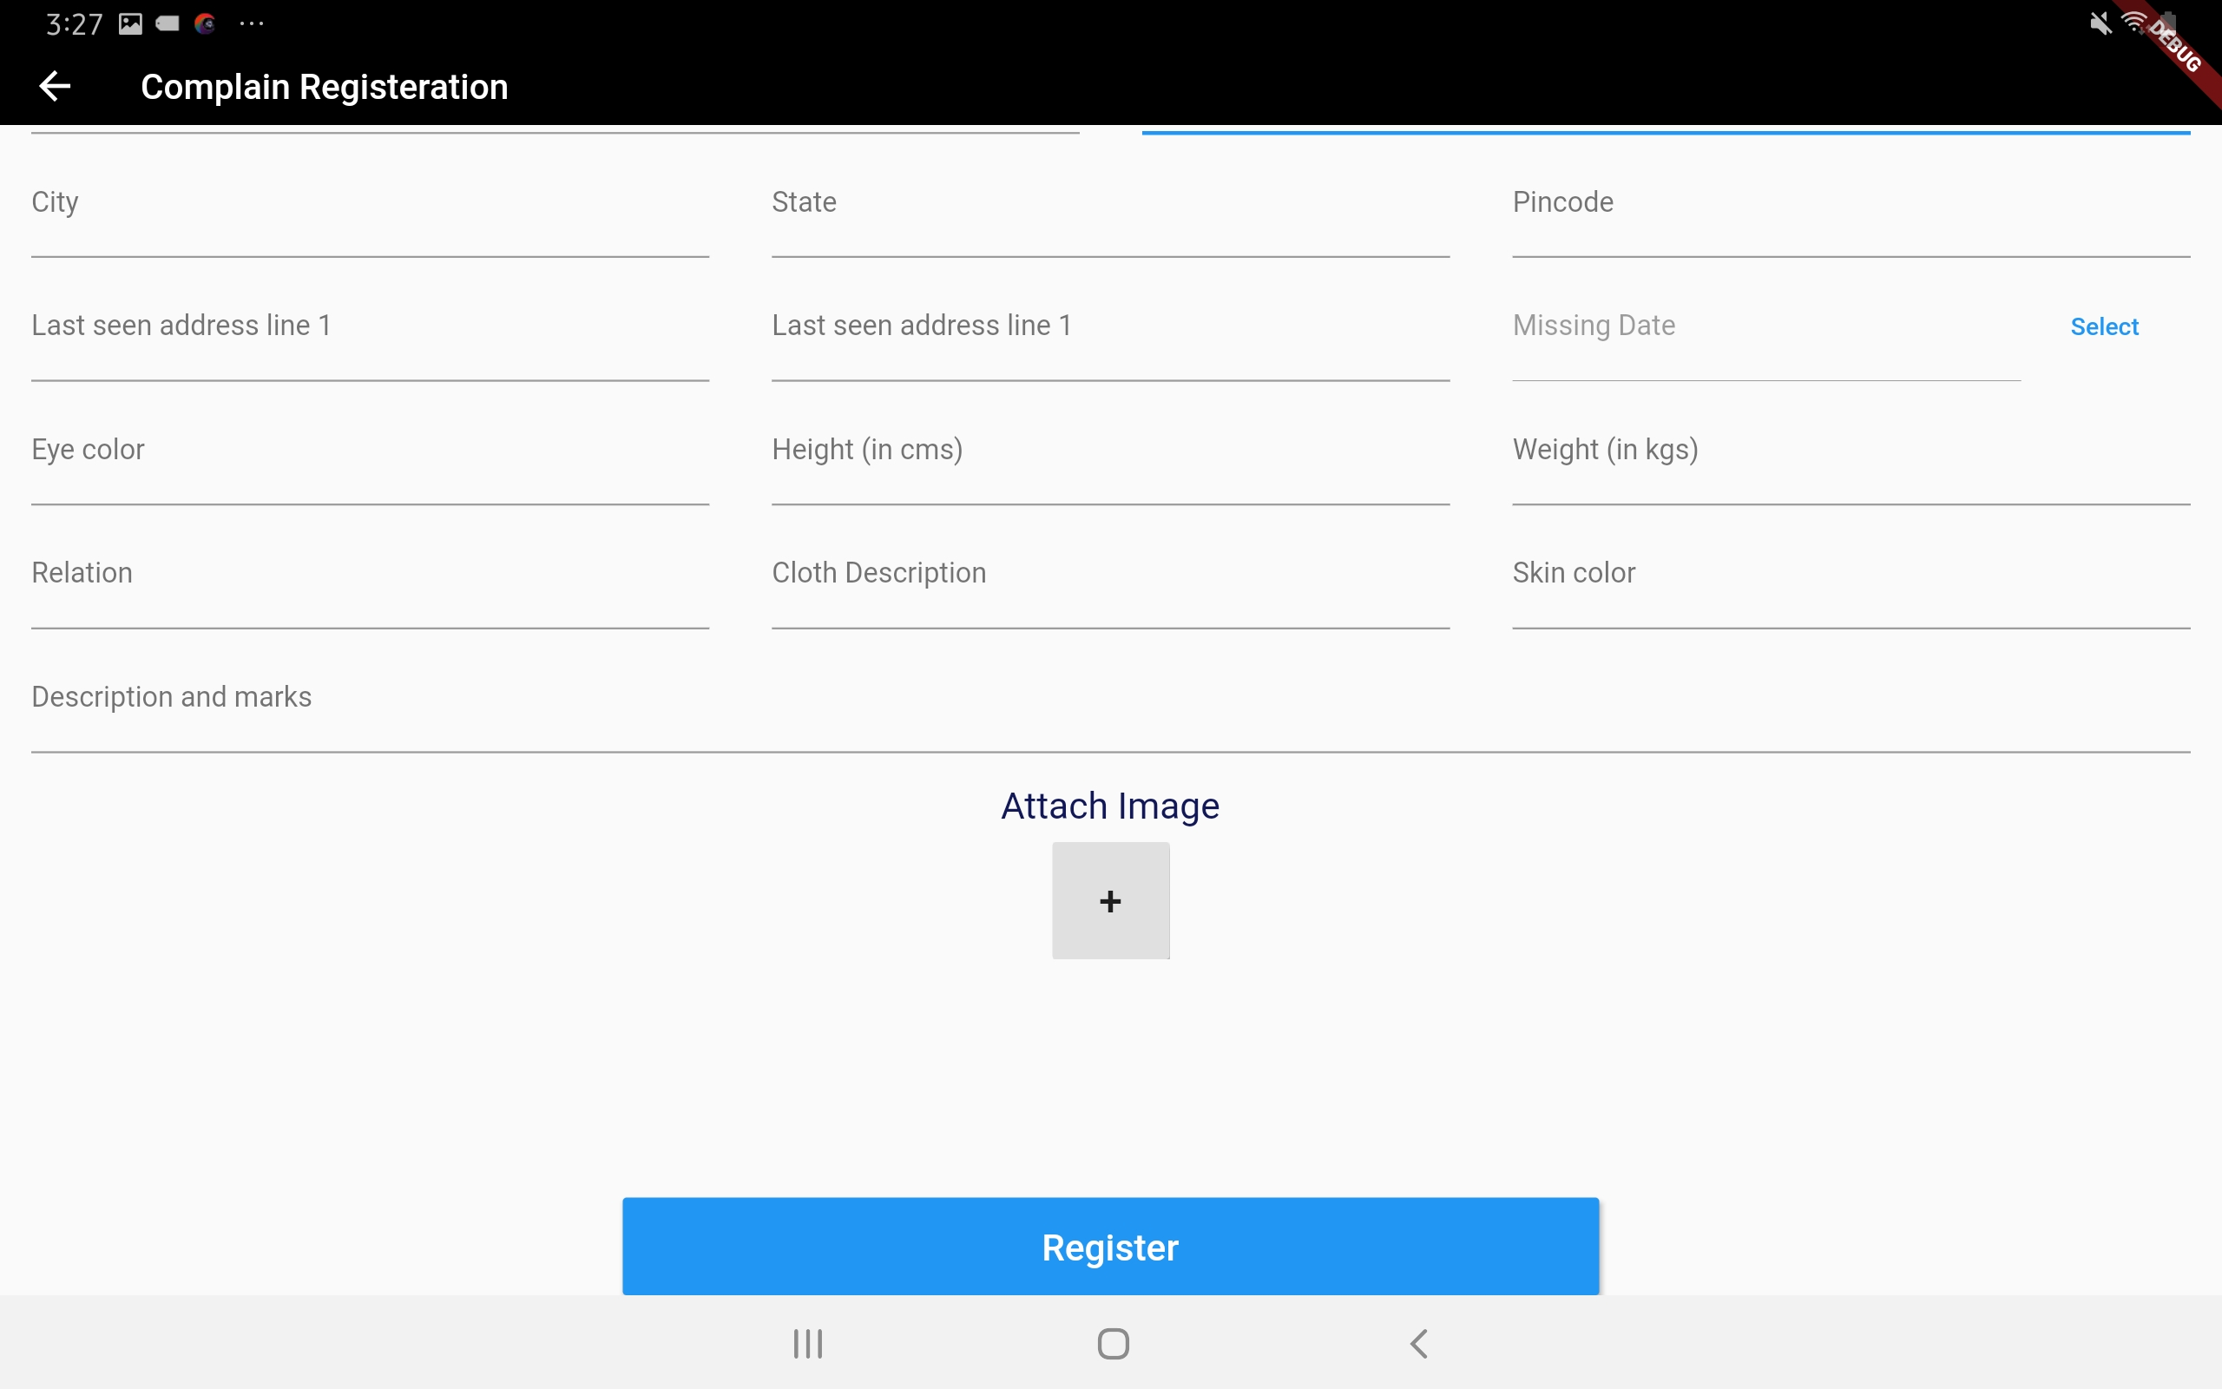
Complaint Page

Slide 25

Thank You

